Slide 1

Amazon Sales Data

Slide 2
INTRODUCTION
Amazon (Amazon.com) is the world's largest online retailer and a prominent cloud service provider.
Following an Amazon-to-buyer sales approach, the company offers a monumental product range and inventory, enabling consumers to buy just about anything, including clothing, beauty supplies, gourmet food, jewelry, books, movies, electronics, pet supplies, furniture, toys, garden supplies and household goods.

Slide 3
KPI
Total Revenue : Sum of all revenues.
Total Profit : Sum of all profits.
Units Sold : Total number of units sold.
Average Order Value : Total Revenue divided by the number of orders.

Slide 4
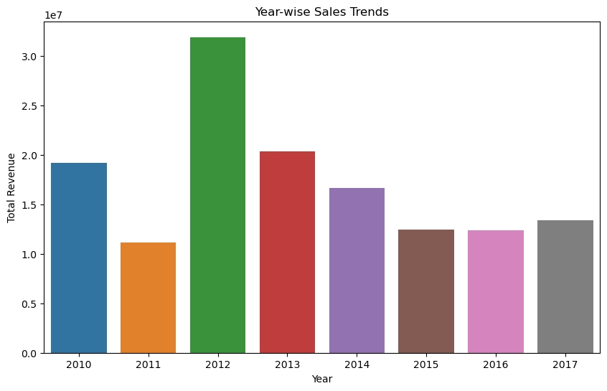

Slide 5
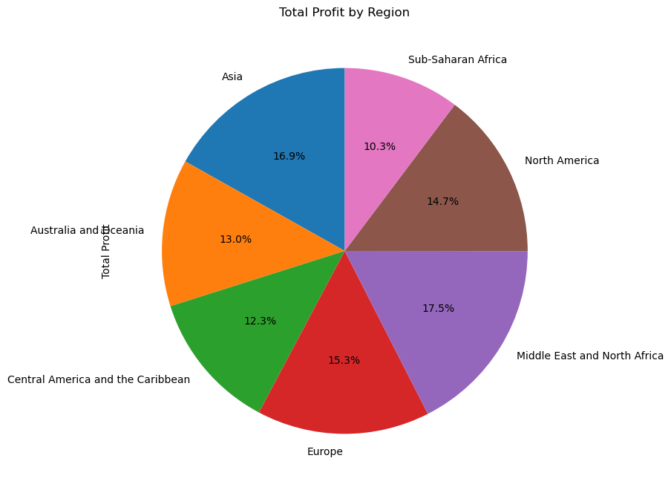

Slide 6
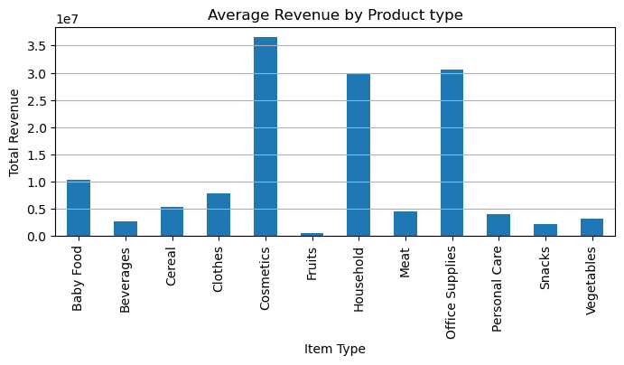

Slide 7
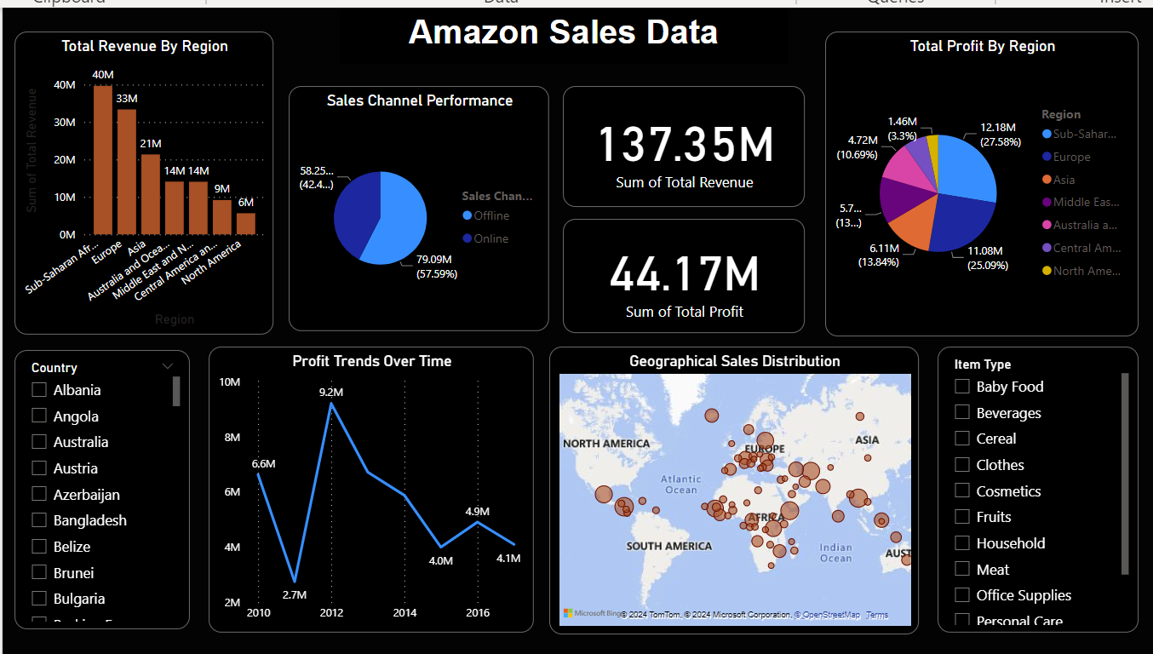

Slide 8
THANKYOU

